Slide 1
Factory Design Pattern

Slide 2
Definition
A Factory Design Pattern says that just define an interface or abstract class for creating an object but let the subclasses decide which class to instance.
In other words, subclasses are responsible to create the instance of the class.
In Factory Design Pattern, we create object without exposing the creation logic to the client and refer to newly created object using common interface.

Slide 3
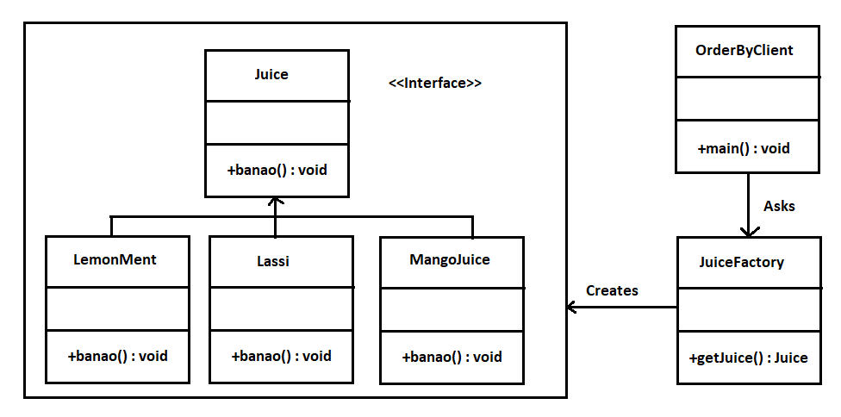
Story of a Juice Factory

Slide 4
How to implement?
Lets build our own Juice Factory..

Slide 5

Q&A Time

